Slide 1


NEW BARN CHURCH
2026
THE RIGHTEOUSNESS
WE
Can not Fake

Slide 2



NEW BARN CHURCH
2026
LEGO, COFFEE, GYM & FRIENDS
Something about me.

Slide 3
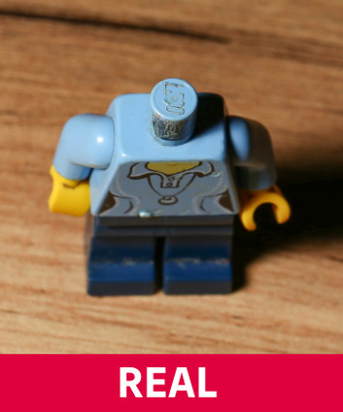
NEW BARN CHURCH
2026
FAKE LEGO
FAKE VS
REAL
NO LOGO ON THE BRICKS
CHEAP QUALITY/ COSTING
CONFUSING INSTRUCTIONS

Slide 4

NEW BARN CHURCH
2026
1)ARE WE SEEING JESUS CLEARLY?

Slide 5
NEW BARN CHURCH
2026
MATTHEW
5:17–18
17 “Do not think that I have come to abolish the Law or the Prophets; I have not come to abolish them but to fulfil them. 18 For truly I tell you, until heaven and earth disappear, not the smallest letter, not the least stroke of a pen, will by any means disappear from the Law until everything is accomplished.

Slide 6
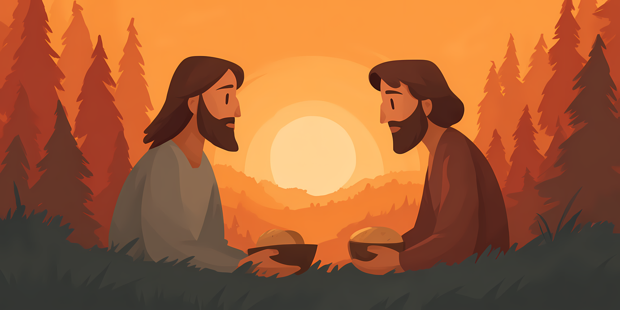
NEW BARN CHURCH
2026
WHAT THE PHARISEES
HELD AGAINST JESUS
HE ATE AND SAT WITH SINNERS
HE DIDN’T KEEP THE LAW IN THEIR EYES (HEALING SABBATH)
SPENT TIME WITH THE ‘UNCLEAN’
HIS DISCIPLES WERE CHOSEN!

Slide 7
NEW BARN CHURCH
2026
MATTHEW
5:19-20
Therefore, anyone who sets aside one of the least of these commands and teaches others accordingly will be called least in the kingdom of heaven, but whoever practices and teaches these commands will be called great in the kingdom of heaven. 20 For I tell you that unless your righteousness surpasses that of the Pharisees and the teachers of the law, you will certainly not enter the kingdom of heaven.

Slide 8

NEW BARN CHURCH
2026
RIGHT PIECES, WRONG BUILD
WHAT ARE WE EXPECTING FROM JESUS? WHAT DOES JESUS EXPECT FROM US? HAVING ALL THE RIGHT PIECES BUT BUILDING THE WRONG THING MISSES THE DESIGNER'S PURPOSE.

Slide 9
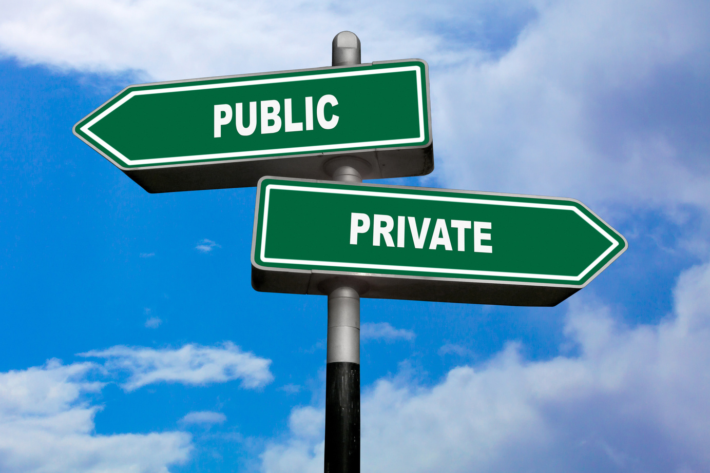
NEW BARN CHURCH
2026
1)WHAT IS IT THAT WE ARE EXPECTING ?
2) WHAT DOES JESUS EXPECT FROM US?
Jesus isn't asking us to perform better than they did. He's calling us to something deeper—a righteousness that comes from a genuine relationship with Him, producing hearts that love God, obey His Word, and reflect His character.

Slide 10
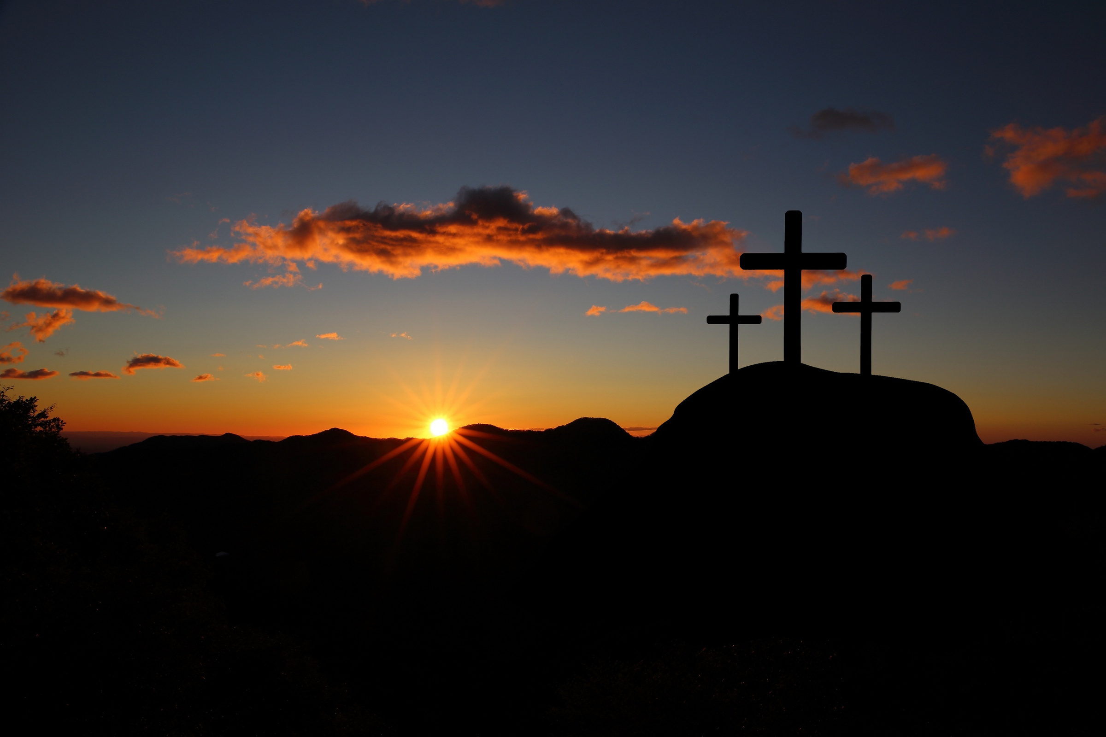
NEW BARN CHURCH
2026
2) ARE WE FOLLOWING JESUS FAITHFULLY?

Slide 11

NEW BARN CHURCH
2026
WHY PRACTICE AT ALL?

Slide 12
NEW BARN CHURCH
2026
MATTHEW 23:1-4
Then Jesus said to the crowds and to his disciples: 2 “The teachers of the law and the Pharisees sit in Moses’ seat. 3 So you must be careful to do everything they tell you. But do not do what they do, for they do not practice what they preach. 4 They tie up heavy, cumbersome loads and put them on other people’s shoulders, but they themselves are not willing to lift a finger to move them.

Slide 13

NEW BARN CHURCH
2026
PATIENCE & LOVE IN ACTION

Slide 14
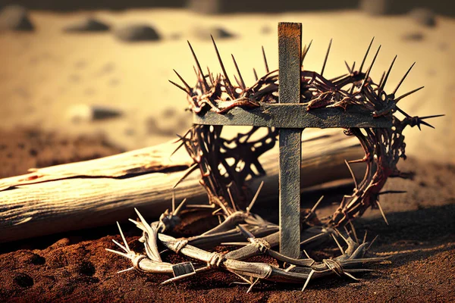

Slide 15

NEW BARN CHURCH
2026
3) ARE WE GLORIFYING JESUS FULLY?

Slide 16

NEW BARN CHURCH
2026
GOSPEL TRUTH
THE GREAT EXCHANGE

Slide 17
NEW BARN CHURCH
2026
2 CORINTHIANS 5:21
God made him who had no sin to be sin for us, so that in him we might become the righteousness of God.

Slide 18

NEW BARN CHURCH
2026
CONCLUSION: THE CRACKS SHOW
FAITH CAN LOOK REAL ON THE OUTSIDE — BUT FALL APART WHEN IT'S BUILT ON THE WRONG FOUNDATION. ARE WE SEEING JESUS CLEARLY? FOLLOWING FAITHFULLY? GLORIFYING HIM FULLY? REJECT THE FAKE. BUILD ON WHAT IS TRUE.

Slide 19
NEW BARN CHURCH
2026
CALL TO ACTION
TRUST THE KING
STOP BUILDING YOUR OWN VERSION OF RIGHTEOUSNESS. TRUST THE KING WHO BOTH DEMANDS AND PROVIDES IT. TO HIM ALONE BE ALL THE GLORY.

